Slide 1
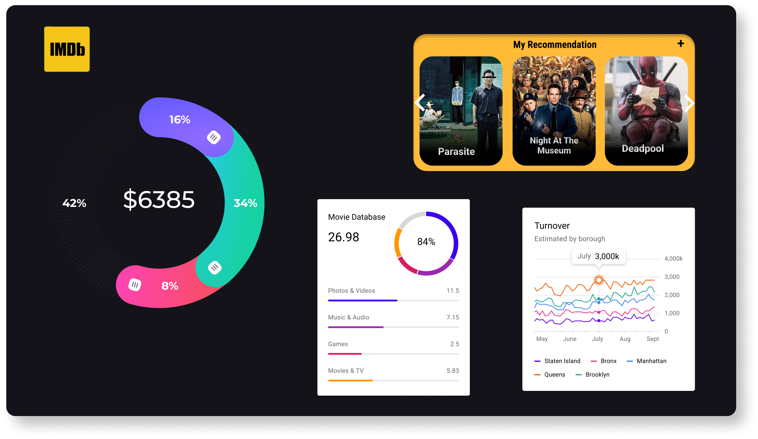
IMDB Movie Analysis
By ANANWITA Sarkar

Slide 2
Problem Description: The goal of this IMDb movie analysis is to explore a comprehensive dataset containing information about various movies, including attributes such as IMDb ratings, budgets, gross earnings, director names, genres, and actors. By conducting this analysis, I aim to gain valuable insights into the trends, patterns, and preferences in the world of cinema and answer key questions related to movie ratings, profitability, popular genres, and influential figures in the industry.
Approach: The IMDb movie analysis involves loading, preprocessing and cleaning the dataset, analyzing the distribution and trends, exploring and identifying the exact data. The approach includes grouping data, finding the reason and analyzing the impact. Influential actors' influence on movie performance and top-rated, top-grossing movies for actors will be examined with visualizations.
Tech-stack used: The tech stack for IMDb movie analysis involves Microsoft Excel for data loading, preprocessing, and calculations. Excel's functions and features are used for IMDb ratings distribution, profit calculation, genre analysis, and actor statistics. Charts and graphs are utilized for visualizations, enabling the exploration of trends and insights in the movie dataset.

Slide 3
Case Study:
Cleaning the data: This is the most significant initial step to perform analysis like removing redundant data, null values, etc.
Movies with highest profit: Find out the movies that have the highest profit with observing outliers.
Top 250: Find out the topmost 250 movies that has highest IMDB score. Find the same for foreign language movies.
Best Directors: In this task find out the top 10 best directors those who have highest mean of IMDB ratings
Popular Genres: In this task find out the popular genres.
Critic and Audience fav actors: In this task find out the favourite actors who have the highest critic and user reviews while having the combined chart of the sum of voted users vs its decades.

Slide 4
Case Study 1: Cleaning the data
Removed all duplicate values
Removed all null values
Removed all redundant and cluttered values
Insights: After cleaning the dataset, there were a total of 3724 rows and 14 columns.

Slide 5
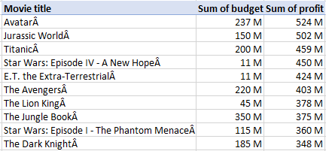
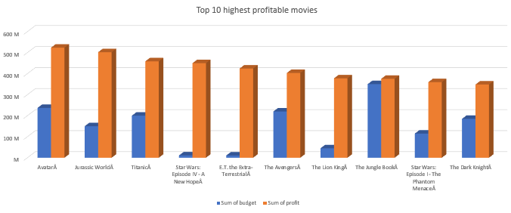
Case Study 2: Movies with highest profit
Insights: From this chart we can say that movies with high budget and good script are able to make maximum profit.

Slide 6
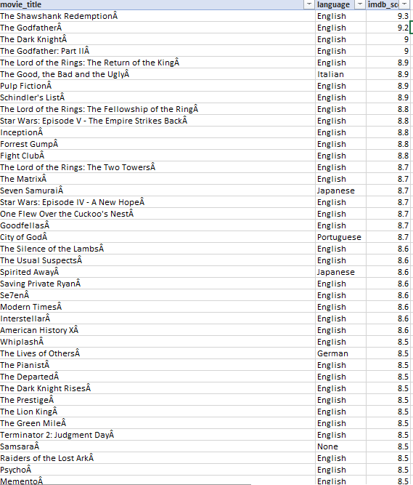
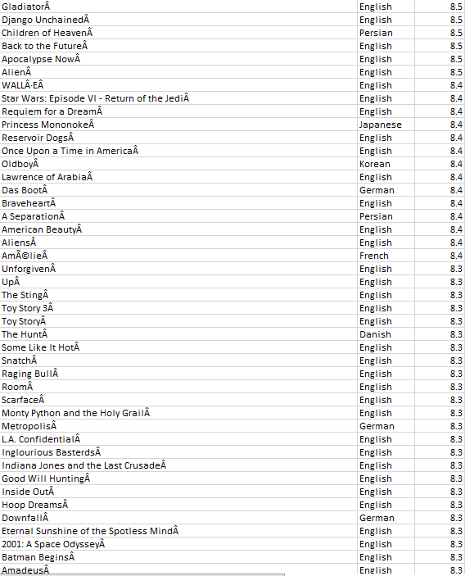
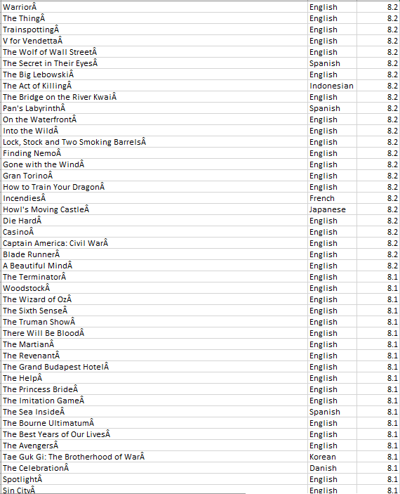
Case Study 3: Top 250

Slide 7
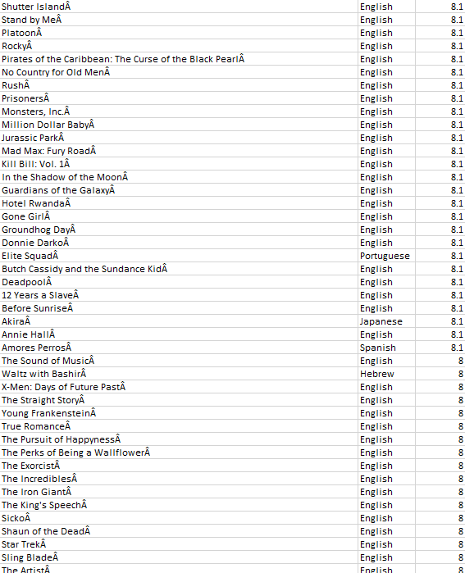
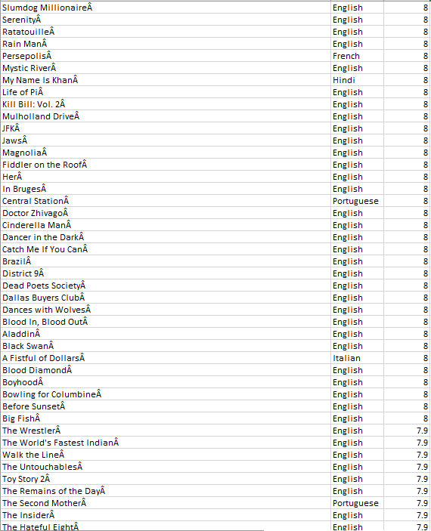
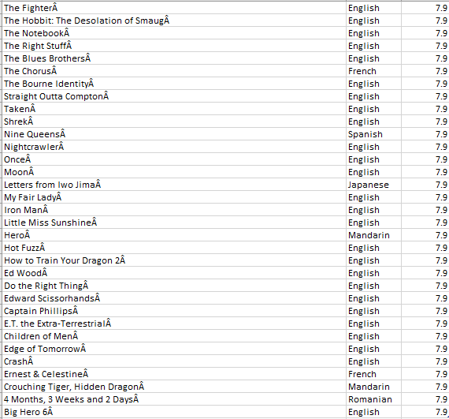
Case Study 3: Top 250
Insights: From this chart we can see that there are maximum English movies in the list since English is used in almost every part of the world along with good script and acting.

Slide 8
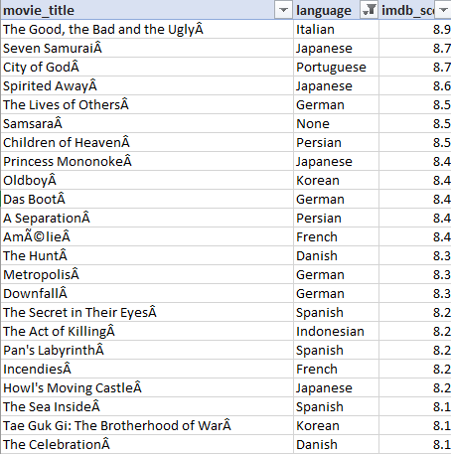
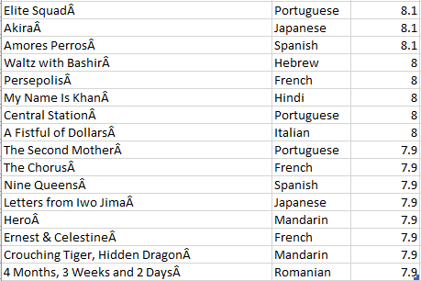
Case Study 3: Top Foreign language movies from top 250 movies
Insights: From this chart we can see that there were a total of 39 movies in foreign language.

Slide 9
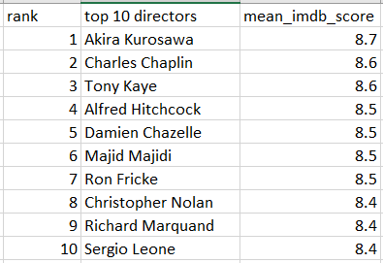
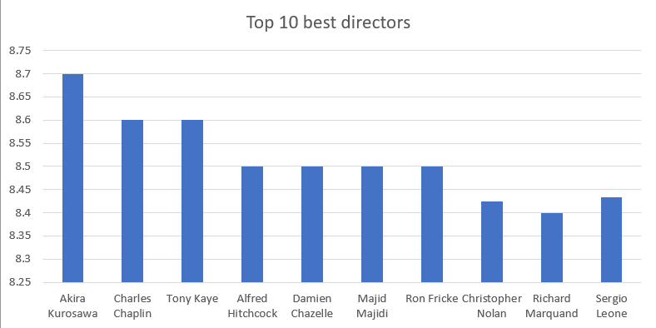
Case Study 4: Top 10 best directors who have the highest mean IMDB rating.
Insights: From this we can see that directors Akira Kurosawa and Charles Chaplin have the highest mean IMDB score with 8.7 and 8.6 ratings respectively.

Slide 10
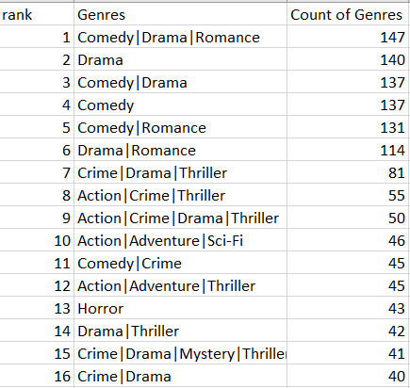
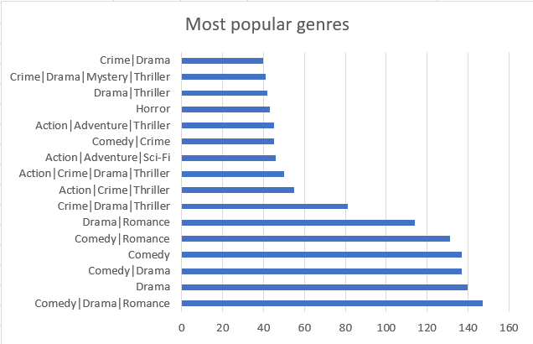
Case Study 5: Popular genres.
Insights: From this we can see that comedy, drama and romance are the most liked genres by the audience.

Slide 11
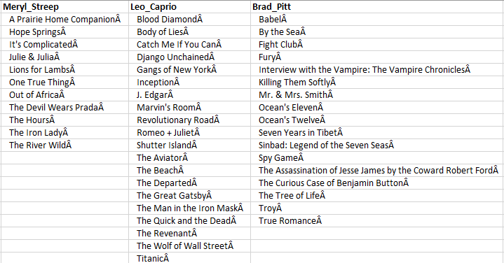
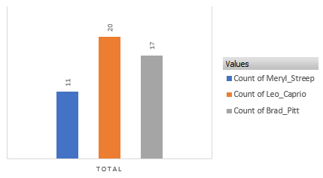
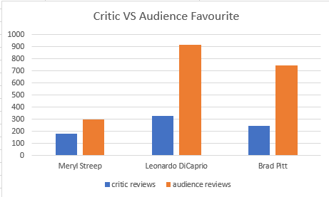
Case Study 6: Critic and audience favourite actors.
All the movies done by actors Meryl Streep, Leonardo DiCaprio, Brad Pitt, their counts and their respective reviews from critics and users.
Insights: From this we can see that Leonardo DiCaprio has done the highest number of movies among the three actors and no doubt he is the most favourite actor of both the audience and critics.

Slide 12
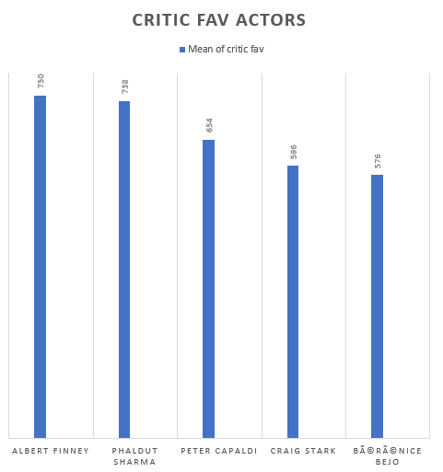
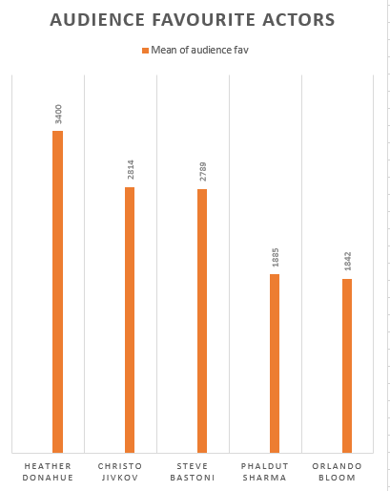
Case Study 5: Critic and audience favourite actors.
Actors who have the overall highest mean of critic and audience reviews respectively.
Insights: From this we can see that Albert Finney is the critic favourite actor and Heather Donahue is the audience favourite actor.

Slide 13
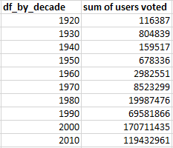
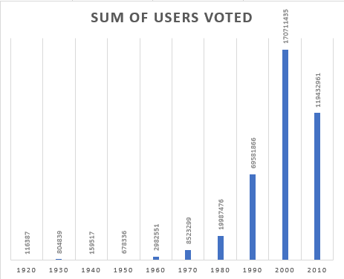
Case Study 5: Critic and audience favourite actors.
Observe the change in the number of voted users over the decades.
Insights: From this we can see that the number of voters has been increasing over the decades but has experienced a significant decrease in the most recent decade.

Slide 14
Results:
During the course of this project, I have achieved several key outcomes and gained valuable knowledge through the results obtained:
IMDb Top 250 Movies: Identified the top 250 movies based on IMDb ratings, providing insights into the most highly acclaimed films.
Profitable Movies: Determined the top-grossing movies by calculating profits from the difference between gross earnings and budgets, understanding financial success in the film industry.
Best Directors: Analyzed directors' IMDb scores and identified the top 10 directors with the highest mean ratings, recognizing influential figures in cinema.
Popular Genres: Explored genre distributions and their impact on IMDb ratings and earnings, understanding audience preferences.
Critic and Audience Favorite Actors: Identified actors whose movies received the highest mean critic and audience reviews, acknowledging actors' influence on movie performance.
Through these analyses, I have gained insights into the factors contributing to a movie's success, including IMDb ratings, profitability, and audience preferences. I now understand the significance of directors and actors in shaping a film's reception and the impact of genres on movie ratings and earnings. Additionally, I have honed my data analysis skills, including data preprocessing, visualization, and statistical analysis, using Excel. This project has provided me with a deeper understanding of the movie industry's dynamics and the tools necessary for effective data analysis.
Link to the excel file: https://docs.google.com/spreadsheets/d/1HlXHkM-bd_cKskoummgqxOgiCM9P5-np/edit?usp=sharing&ouid=110621318643149679011&rtpof=true&sd=true

Slide 15
THANK YOU

